Slide 1

Java 8
What is Java
Java is a high programming language
Java is a high level, robust, secured and object-oriented programming language.
Where it is used
Desktop Applications such as acrobat reader, media player, antivirus etc.
Web Applications such as irctc.co.in, amazon.com and etc.
Enterprise Applications such as banking applications.
Mobile
Embedded System
Smart Card
Robotics & Games etc.

Slide 2
Java 8
Java Platforms / Editions
Java SE (Java Standard Edition)
Java EE (Java Enterprise Edition)
It is built on the top of Java SE platform. It includes topics like Servlet, JSP, Web Services, EJB, JPA etc.
3) Java ME (Java Micro Edition)
It is a micro platform which is mainly used to develop mobile applications.
4) JavaFx
It is used to develop rich internet applications. It uses light-weight user interface API.

Slide 3
Java 8
Types of Java Applications
Standalone Application // pdf reader,paint etc..
Web Application // Amazon.com, irctc.com
Enterprise Application //www.sbionlinebanking.com
4) Mobile Application //Pubg, Whatsapp

Slide 4
Java 8
Java Version History
Java Version’s
JDK Alpha and Beta (1995) | Java SE 7 (28th July, 2011)
JDK 1.0 (23rd Jan, 1996) | Java SE 8 (18th March, 2014)
JDK 1.1 (19th Feb, 1997) | Java SE 9 (21st Sep, 2017)
J2SE 1.2 (8th Dec, 1998) | Java SE 10 (20th March, 2018)
J2SE 1.3 (8th May, 2000) | Java SE 11(Sep 2018)
J2SE 1.4 (6th Feb, 2002) | Java SE 12(March,2019)
J2SE 5.0 (30th Sep, 2004) | Java SE 13(24 July,2019)
Java SE 6 (11th Dec, 2006) | Upcoming Version is : Java SE 22 (19th March 2024)

Slide 5
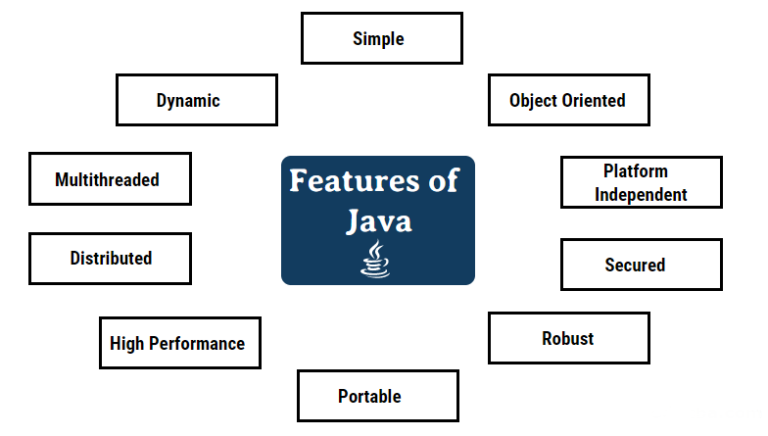
Java 8
Types of Java Features

Slide 6
Java 8
Difference between C++ & Java
Comparison Index | C++ | Java
Platform-independent | C++ is platform-dependent. | Java is platform-independent.
Mainly used for | C++ is mainly used for system programming. | Java is mainly used for application programming. It is widely used in window, web-based, enterprise and mobile applications.
Multiple inheritance | C++ supports multiple inheritance. | Java doesn't support multiple inheritance through class. It can be achieved by interfaces in java.
Pointers | C++ supports pointers. You can write pointer program in C++. | Java supports pointer internally. But you can't write the pointer program in java. It means java has restricted pointer support in java.
Compiler and Interpreter | C++ uses compiler only. | Java uses compiler and interpreter both.
Call by Value and Call by reference | C++ supports both call by value and call by reference. | Java supports call by value only. There is no call by reference in java.

Slide 7
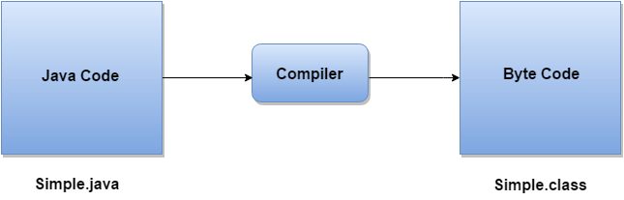
Java 8
What happens at compile time?
At compile time, java file is compiled by Java Compiler (It does not interact with OS) and converts the java code into bytecode.

Slide 8
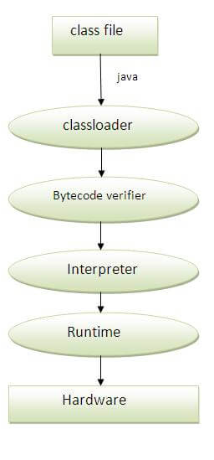
Java 8
What happens at runtime?
Classloader: is the subsystem of JVM that is used to load class files.
Bytecode Verifier: checks the code fragments for illegal code that can violate access right to objects.
Interpreter: read bytecode stream then execute the instructions.

Slide 9
Java 8
JVM JRE JDK
The java programming college is a high-level programming language
A program developed in a high-level language cannot be directly executed on any machine. It should first be translated into that specific machine language for its execution
This is where the need for JDK JRE and JVM comes into the picture.
Although JDK JRE and JVM are interrelated

Slide 10
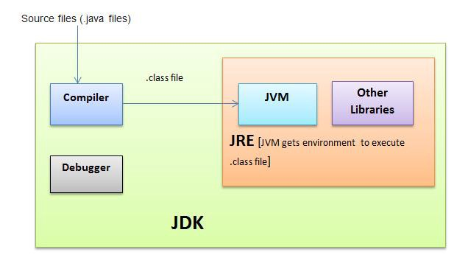
Java 8
What is JDK?
JDK is an abbreviation for Java Development Kit.
JDK is platform-dependent, so separate installers are needed for Windows, Unix, and Mac operating systems.

Slide 11
Java 8
Contin…
JDK and JRE: The JDK allows programmers to write core Java programs that can be executed by the JRE, which includes the JVM and class libraries.
Class Libraries: It is a collection of dynamically loadable libraries that Java programmers can use during runtime(Applets, Util, Lang).
Compilers: Javac is the primary compiler in Java. It is a Java application that accepts developers’ text files and compiles them into Java class files. It is the most frequent type of output given by a compiler that contains Java byte code.
Debuggers: This helps developers in testing and debugging Java programs.

Slide 12
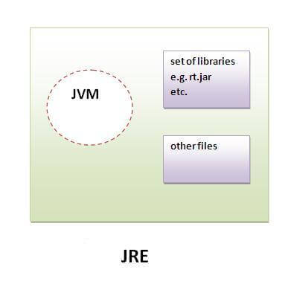
Java 8
What is JRE?
JRE stands for Java Runtime Environment, and it is the implementation of JVM.
It does not contain any tools like a debugger, compiler, etc., for Java development. Developers can simply run source code with JRE, but they cannot develop or compile Java programs.

Slide 13
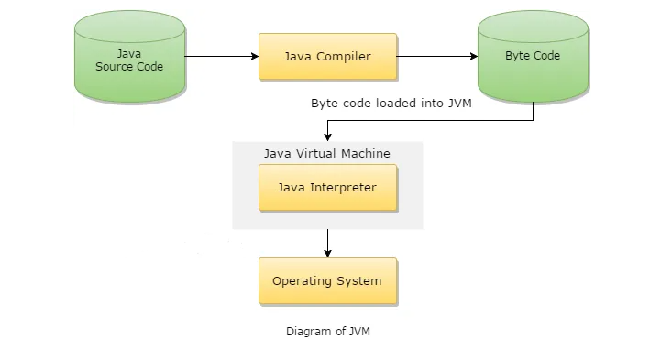
Java 8
What is JVM?
JVM's work can be explained in the following manner
Reading Bytecode.
Verifying bytecode.
Linking the code with the library.

Slide 14
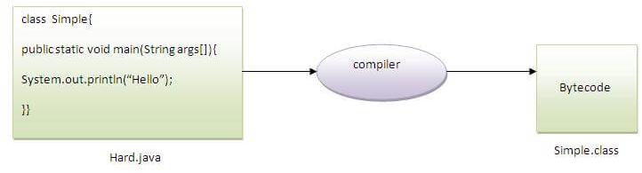
Java 8
Can you save a java source file by other name than the class name?
Yes, if the class is not public. It is explained in the figure given below:
To compile : javac Hard.java
To execute : java Simple

Slide 15
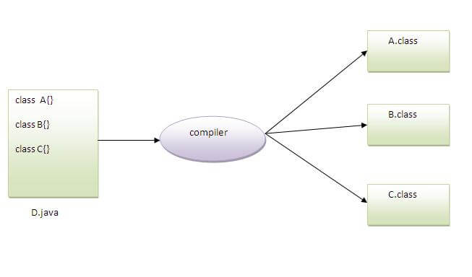
Java 8
Can you have multiple classes in a java source file?
Yes, like the figure given below illustrates:

Slide 16
Java 8
Variables and Data Types in Java
A variable is a container which holds the value while the java program is executed.
A variable is assigned with a datatype.
Variable is a name of memory location.
Variable is name of reserved area allocated in memory.
int data=50;
//here data is variable

Slide 17
Java 8
Types Variables
1) Local Variable
A variable declared inside the method is called local variable.
2) Instance Variable
A variable declared inside the class but outside the method, is
called instance variable . It is not declared as static.
3) Static variable
A variable which is declared as static is called static variable. It cannot be local.
Notes:
Ref : 1 to 19

Slide 18
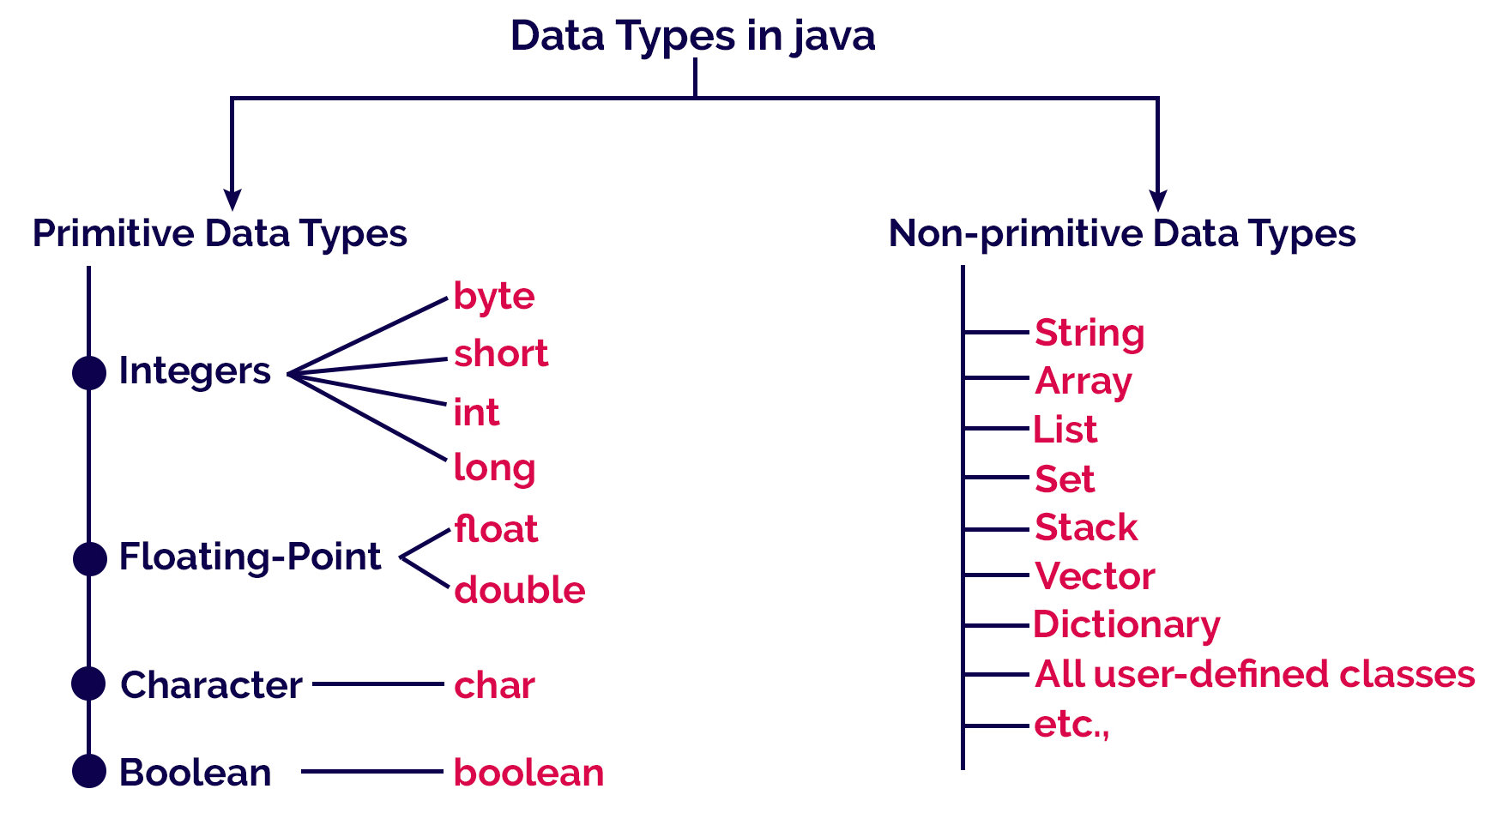
Java 8
Java Data Types
Java programming language has a rich set of data types.
The data type is a category of data stored in variables.

Slide 19
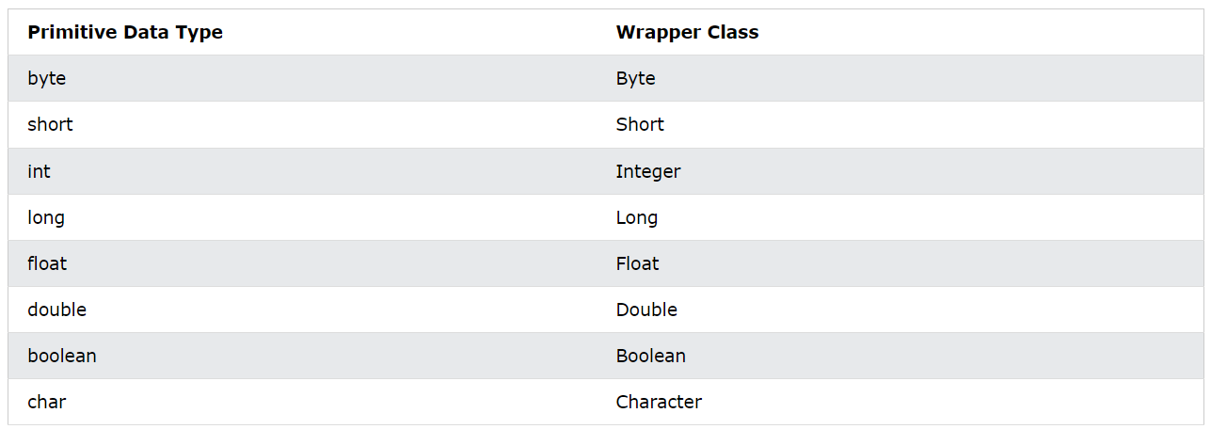
Java 8
Java Wrapper Classes
Wrapper classes provide a way to use primitive data types (int, boolean, etc..) as objects.
The table below shows the primitive type and the equivalent wrapper class:

Slide 20
Java 8
Description Of Each Primitive Data Type
Data type | Meaning | Memory size | Range | Default Value
byte | Whole numbers | 1 byte | -128 to +127 | 0
short | Whole numbers | 2 bytes | -32768 to +32767 | 0
int | Whole numbers | 4 bytes | -2,147,483,648 to +2,147,483,647 | 0
long | Whole numbers | 8 bytes | -9,223,372,036,854,775,808 to +9,223,372,036,854,775,807 | 0L
float | Fractional numbers | 4 bytes | - | 0.0f
double | Fractional numbers | 8 bytes | - | 0.0d
char | Single character | 2 bytes | 0 to 65535 | \u0000
boolean | unsigned char | 1 bit | True or False | 0 (false)

Slide 21
Java 8
Java Type Casting
Type casting is when you assign a value of one primitive data type to another type.
Widening Casting (automatically)
converting a smaller type to a larger type size
byte -> short -> char -> int -> long -> float -> double
Narrowing Casting (manually)
converting a larger type to a smaller size type
double -> float -> long -> int -> char -> short -> byte
Notes:
Ref Note : 20 to 45

Slide 22
Java 8
Java Operators
Operator Type | Category | Precedence
Unary | postfix | expr++ expr--
 | prefix | ++expr --expr
Arithmetic | multiplicative | * / %
 | additive | + -
Shift | shift | << >> >>>
Relational | comparison | < > <= >=
 | equality | == !=
Bitwise | bitwise AND | &
 | bitwise exclusive OR | ^
 | bitwise inclusive OR | |
Logical | logical AND, logical OR | && ||
Ternary | ternary | ? :
Assignment | assignment | = += -= *= /= %= &=

Slide 23
Java 8
Java Conditional Statements & Loops
Conditional Statements | Loops
If | For Loop
If-else | While Loop
Else-if Ladder | Do-While Loop
Nested If | For-Each
Switch
Notes:
Ref Note : 32 to 76

Slide 24
Java 8
Java Conditional Statements & Loops
Conditional Statements | Loops
If | For Loop
If-else | While Loop
Else-if Ladder | Do-While Loop
Nested If | For-Each
Switch
Notes:
Ref Note : 32 to 76

Slide 25
Java 8
Java Identifiers
All Java components require names. Names used for classes, variables, and methods are called identifiers.
Identifiers Rules,
All identifiers should begin with a letter (A to Z or a to z), currency character ($) or an underscore (_).
After the first character, identifiers can have any combination of characters.
A key word cannot be used as an identifier.
Most importantly, identifiers are case sensitive.
Examples of legal identifiers: age, $salary, _value, __1_value.
Examples of illegal identifiers: 123abc, #salary,&salary.
Notes:
Ref Note : 32 to 76

Slide 26
Java 8
Java Naming Convention
Java naming convention is a rule to follow as you decide what to name your identifiers such as class, package, variable, constant, method, etc.
Pascal Case – Class Name – Ex. FacePrep, CalculatorProgram
Camel Case – Method Name – Ex. additionLogic, divisionLogic
Snake Case – Variable Name – Ex. Student_age, student_mark
Notes:
Ref Note : 32 to 76

Slide 27
Java 8
Java - What is OOP?
OOP stands for Object-Oriented Programming.
Object-oriented programming has several advantages over procedural programming:
OOP is faster and easier to execute
OOP provides a clear structure for the programs
OOP helps to keep the Java code DRY "Don't Repeat Yourself", and makes the code easier to maintain,
modify and debug OOP makes it possible to create full reusable applications with less code and shorter development time

Slide 28
Java 8
Java OOP – Class
Class :
A class is a group of objects which have common properties.
It is a template or blueprint from which objects are created.
It is a logical entity. It can't be physical entity.
A Class in Java can contain:
Fields
Methods
Constructors
Blocks
Nested class and interface

Slide 29
Java 8
Java OOP – Objects
Object :
An entity that has state and behavior is known as an object
State: represents the data (value) of an object.
Behavior: represents the behavior (functionality) of an object such as deposit, withdraw, etc.
Syntax :
Class_name Object_name = new Constructor_of_class();

Slide 30
Java 8
Java Methods
A method is a block of code which only runs when it is called.
You can pass data, known as parameters, into a method.
Methods are used to perform certain actions, and they are also known as functions.
Why use methods? To reuse code: define the code once, and use it many times.
public class Main {
static void myMethod() {
System.out.println("I just got executed!");
}
public static void main(String[] args) {
myMethod();
}
}

Slide 31
Java 8
Class Syntax
AccessSpecifier class ClassName{
}
Object Creation Syntax
ClassName ObjectName = new ConstructorOfTheClass();
Method Syntax
AccessSpecifier AccessModifier(Optional) ReturnType MethodName(Parameters) {
}

Slide 32
Java 8
Inheritance
In Java, it is possible to inherit attributes and methods from one class to another.
We group the "inheritance concept" into two categories:
subclass (child) - the class that inherits from another class
superclass (parent) - the class being inherited from
To inherit from a class, use the extends keyword.

Slide 33
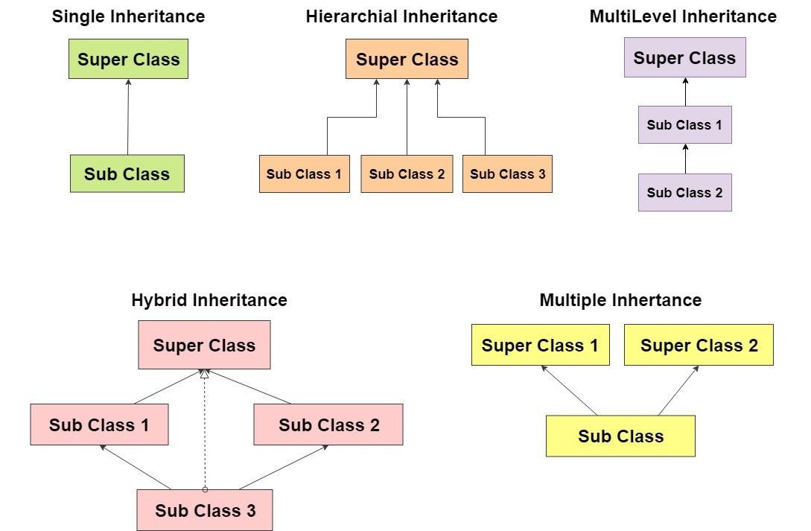
Java 8
Types of Inheritance
Notes:
Ref Notes : 79 to 183

Slide 34
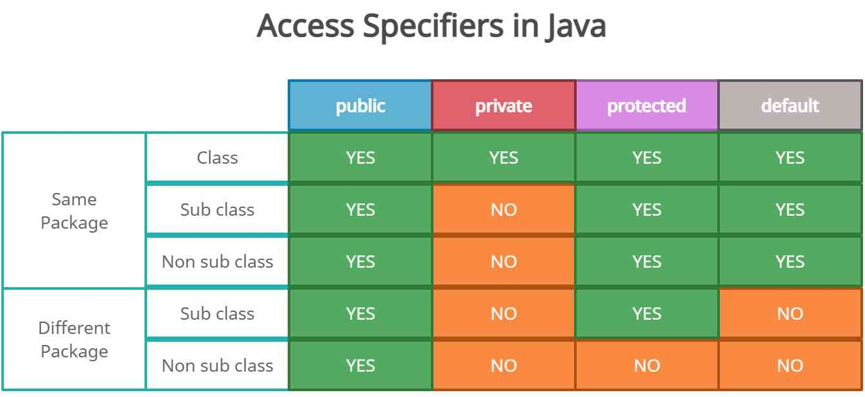
Java 8
Access Specifiers
Notes:
Ref Notes ; 185 to 230

Slide 35
Java 8
Polymorphism
Polymorphism in java is a concept by which we can perform a single action by different ways.
Polymorphism is derived from 2 Greek words: poly and morphs.
The word "poly" means many and "morphs" means forms. So polymorphism means many forms.s
There are two types of polymorphism in java:
Compile time polymorphism
Runtime polymorphism
Notes:
Ref Notes ; 185 to 230

Slide 36
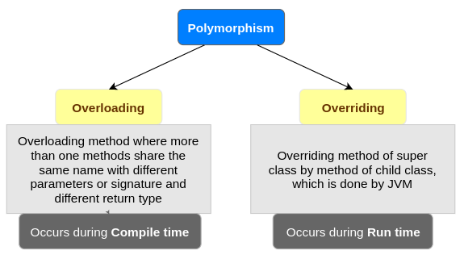
Java 8
Polymorphism
We can perform polymorphism in java by method overloading and method overriding.

Slide 37
Java 8
Method Overriding If subclass (child class) has the same method as declared in the parent class,
it is known as method overriding in java. Usage of Java Method Overriding: 1. Method overriding is used to provide specific implementation of a method that is already provided by its super class. 2. Method overriding is used for runtime polymorphism. Rules for Java Method Overriding: 1. method must have same name as in the parent class. 2. method must have same parameter as in the parent class.

Slide 38
Java 8
Method Overloading If a class has multiple methods having same name but different in parameters, it is known as Method Overloading. There are two ways to overload the method in java: 1. By changing number of arguments 2. By changing the data type

Slide 39
Java 8
Final Keyword In Java
The final keyword in java is used to restrict the user. The java final keyword can be used in many context. Final can be:
Variable - final variable once assigned a value can never be changed.
Method - If you make any method as final, you cannot override it.
Class - If you make any class as final, you cannot extend it.
Notes:
Ref notes : 234 to 285

Slide 40
Java 8
Java static keyword
The static keyword in Java is used for memory management mainly. We can apply static keyword with variables, methods, blocks and nested classes. The static keyword belongs to the class than an instance of the class.
The static can be:
Variable (also known as a class variable)
Method (also known as a class method)
Block
Nested class
Notes:
Ref Notes : 289 to 371

Slide 41
Java 8
Super Keyword in Java
The super keyword in Java is a reference variable which is used to refer immediate parent class object.
Whenever you create the instance of subclass, an instance of parent class is created implicitly which is referred by super reference variable.
Usage of Java super Keyword
super can be used to refer immediate parent class instance variable.
super can be used to invoke immediate parent class method.
super() can be used to invoke immediate parent class constructor.
Notes:
Ref Notes : 374 to 440

Slide 42
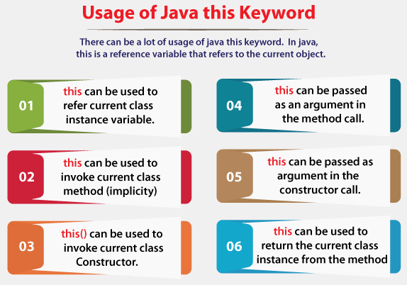
Java 8
This Keyword
Notes:
Ref Notes : 443 to 572

Slide 43
Java 8
Encapsulation
Encapsulation in java is a process of wrapping code and data together into a single unit, for example capsule i.e. mixed of several medicines.
Encapsulation in java We can create a fully encapsulated class in java by making all the data members of the class private. Now we can use setter and getter methods to set and get the data in it.
To achieve encapsulation in Java −
Declare the variables of a class as private.
Provide public setter and getter methods to modify and view the variables values.
Notes:
Ref Notes : 576 to 598

Slide 44
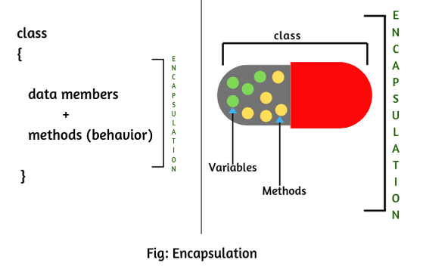
Java 8
Encapsulation
Benefits of Encapsulation
The fields of a class can be made read-only or write-only.
A class can have total control over what is stored in its fields.

Slide 45
Java 8
Abstraction
Abstraction is a process of hiding the implementation details
and showing only functionality to the user.
Another way, it shows only important things to the user and hides the internal details for java sending sms, you just type the text and send the message. You don't know the internal processing about the message delivery.
There are two ways to achieve abstraction in java
1. Abstract class (0 to 100%) 2. Interface (100%)
Notes:
Ref notes : 601 to 635

Slide 46
Java 8
Abstract Class
A class that is declared as abstract is known as abstract class
Abstraction ratio 0% to 100%
It needs to be extended and its method implemented
It cannot be instantiated directly
Abstract class can contain abstract & non-abstract methods
Abstract methods should not have implementation

Slide 47
Java 8
Interface
A class that is declared as interface is known as interface class
Abstraction ratio 100%
It needs to be implemented and its method implemented
It cannot be instantiated directly
Interface can contain only abstract methods
Abstract methods should not have implementation

Slide 48
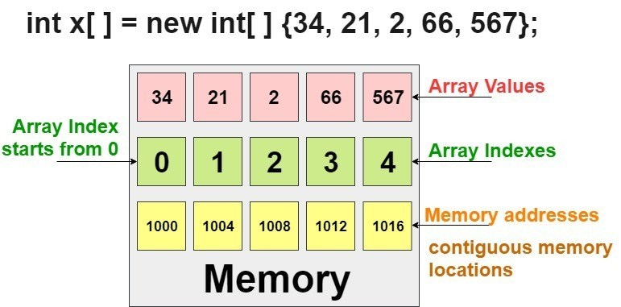
Java 8
Arrays
Array is a collection of similar type of elements that have contiguous memory location
Java array is an object the contains elements of similar data type
We can store only fixed set of elements in a java array
Array in java is index based, first element of the array is stored at 0 index
Notes:
Ref notes : 639 to 956

Slide 49
Java 8
Advantage of Java Array: 1. Code Optimization: It makes the code optimized, we can retrieve or sort the data easily. 2. Random access: We can get any data located at any index position. Disadvantage of Java Array: Size Limit: We can store only fixed size of elements in the array. It doesn't grow its size at runtime. To solve this problem, collection framework is used in java.
Types of Java Array: 1. Single Dimensional Array 2. Multidimensional Array

Slide 50
Java 8
Advantage of Java Array: 1. Code Optimization: It makes the code optimized, we can retrieve or sort the data easily. 2. Random access: We can get any data located at any index position. Disadvantage of Java Array: Size Limit: We can store only fixed size of elements in the array. It doesn't grow its size at runtime. To solve this problem, collection framework is used in java.
Types of Java Array: 1. Single Dimensional Array 2. Multidimensional Array

Slide 51
Java 8
String
Generally, String is a sequence of characters. But in Java, string is an object that represents a sequence of characters.
The java.lang.String class is used to create a string object.
How to create a string object?
By string literal
By new keyword
By String Buffer
By String Builder
Notes:
Ref Notes : 960 to 1178

Slide 52
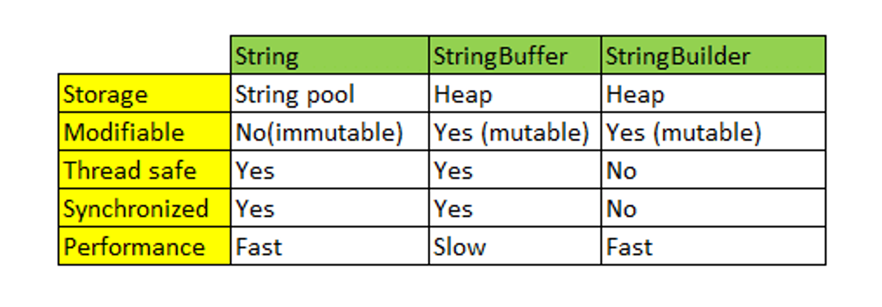
Java 8
Difference Between String / String Buffer / String Budilder

Slide 53
Java 8
By String Literal
Java String literal is created by using double quotes. For Example:
String s="welcome";
Each time you create a string literal, the JVM checks the "string constant pool" first.
If the string already exists in the pool, a reference to the pooled instance is returned.
If the string doesn't exist in the pool, a new string instance is created and placed in the pool.

Slide 54
Java 8
By new keyword
String s=new String("Welcome");
//creates two objects and one reference variable
In such case, JVM will create a new string object in normal (non-pool) heap memory, and the literal "Welcome" will be placed in the string constant pool.
The variable s will refer to the object in a heap (non-pool).

Slide 55
Java 8
By String Buffer
StringBuffer s=new StringBuffer("Welcome");
//creates two objects and one reference variable
In such case, JVM will create a new string object in normal (non-pool) heap memory
It will allow the changes once its created
StringBuffer is a thread safe
Due to thread safe, performance will be slow

Slide 56
Java 8
By String Builder
StringBuilder s=new StringBuilder("Welcome");
//creates two objects and one reference variable
In such case, JVM will create a new string object in normal (non-pool) heap memory
It will allow the changes once its created
StringBuffer is not a thread safe
Performance will be fast (not a thread safe)

Slide 57
Java 8
Exception Handling in Java
The Exception Handling in Java is one of the powerful mechanism to handle the runtime errors so that normal flow of the application can be maintained.
Types of Java Exceptions
There are mainly two types of exceptions: checked and unchecked. An error is considered
as the unchecked exception.
Checked Exception
Unchecked Exception
Notes:
Ref notes : 1181 to 1647

Slide 58
Java 8
Exception Handling – Keywords
Keyword | Description
try | The "try" keyword is used to specify a block where we should place an exception code. It means we can't use try block alone. The try block must be followed by either catch or finally.
catch | The "catch" block is used to handle the exception. It must be preceded by try block which means we can't use catch block alone. It can be followed by finally block later.
finally | The "finally" block is used to execute the necessary code of the program. It is executed whether an exception is handled or not.
throw | The "throw" keyword is used to throw an exception.
throws | The "throws" keyword is used to declare exceptions. It specifies that there may occur an exception in the method. It doesn't throw an exception. It is always used with method signature.

Slide 59
Java 8
Throw vs Throws
Factors | Throw in Java | Throws in Java
Purpose | The 'throw' keyword is used to explicitly throw an exception from within a block of code or a method. | The 'throws' keyword is used in the method signature to declare the exceptions that a method can potentially throw.
Implementation | The 'throw' keyword can only throw a single exception at a time. As such, it is not possible to throw multiple exceptions simultaneously with 'throw'. | The 'throws' keyword allows for the declaration of multiple exceptions that a function could throw.
Usage | The 'throw' keyword should be used within the body of a method. | The 'throws' keyword should be used within the method signature.

Slide 60
Java 8
MULTITHREADING IN JAVA
Multithreading is a Java feature that allows concurrent execution of two or more parts of a program for maximum utilization of CPU.
Each part of such program is called a thread. So, threads are light-weight processes within a process. Threads can be created by using two mechanisms : 1. Extending the Thread class 2. Implementing the Runnable Interface
Notes:
Ref notes : 1651 to 1871

Slide 61
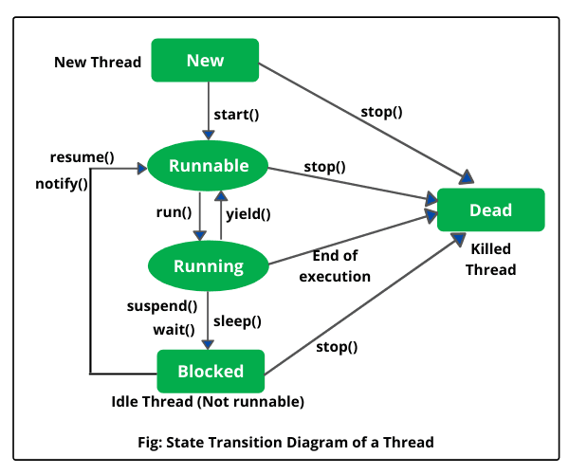
Java 8
MULTITHREADING – Life Cycle

Slide 62
Java 8
MULTITHREADING IN Default Methods
getName(): It is used for Obtaining a thread’s name
getPriority(): Obtain a thread’s priority
isAlive(): Determine if a thread is still running
join(): Wait for a thread to terminate
run(): Entry point for the thread
sleep(): suspend a thread for a period of time
start(): start a thread by calling its run() method

Slide 63
Java 8
Collections
It provides readymade architecture.
The Collection in Java is a framework that provides an architecture to store and manipulate the group of objects.
Java Collections can achieve all the operations that you perform on a data such as searching, sortinsg, insertion, manipulation, and deletion.
Java Collection means a single unit of objects.
Java Collection framework provides many interfaces (Set, List, Map) and classes (ArrayList, Vector, LinkedList, HashSet, LinkedHashSet, TreeSet etc…).
Notes:
Ref Notes : 1875 to 2562

Slide 64
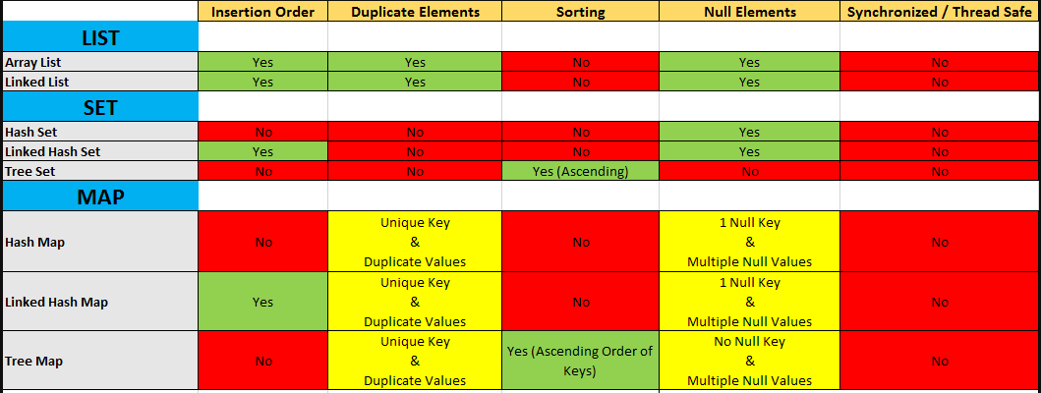
Java 8
Collections

Slide 65
Java 8
Collections
ArrayList | LinkedList
1) ArrayList internally uses a dynamic array to store the elements. | LinkedList internally uses a doubly linked list to store the elements.
2) Manipulation with ArrayList is slow because it internally uses an array. If any element is removed from the array, all the other elements are shifted in memory. | Manipulation with LinkedList is faster than ArrayList because it uses a doubly linked list, so no bit shifting is required in memory.
3) ArrayList is better for storing and accessing data. | LinkedList is better for manipulating data.
5) Generally, when an ArrayList is initialized, a default capacity of 10 is assigned to the ArrayList. | There is no case of default capacity in a LinkedList. In LinkedList, an empty list is created when a LinkedList is initialized.

Slide 66
Java 8
JDBC
JDBC stands for Java Database Connectivity, which is a standard Java API for database-independent connectivity between the Java programming language and a wide range of databases.
Making a connection to a database
Creating SQL or MySQL statements
Executing SQL or MySQL queries in the database
Viewing & Modifying the resulting records
Notes:
Ref notes : 2566 to 2718

Slide 67
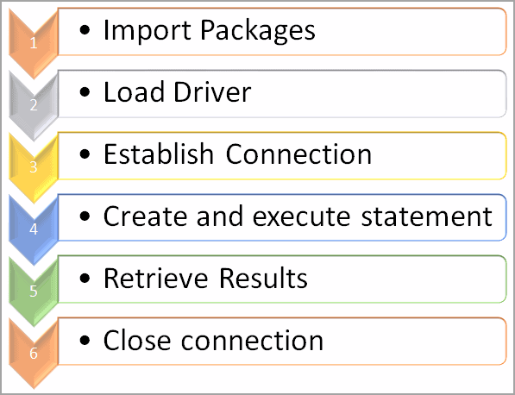
Java 8
JDBC Connectivity Steps

